Slide 1
The lecture 16
Image viewer

Slide 2
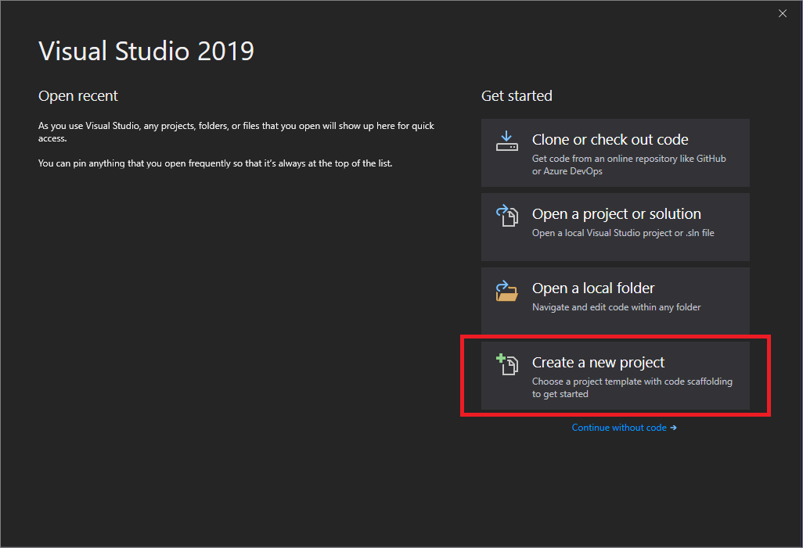
Create a new project

Slide 3
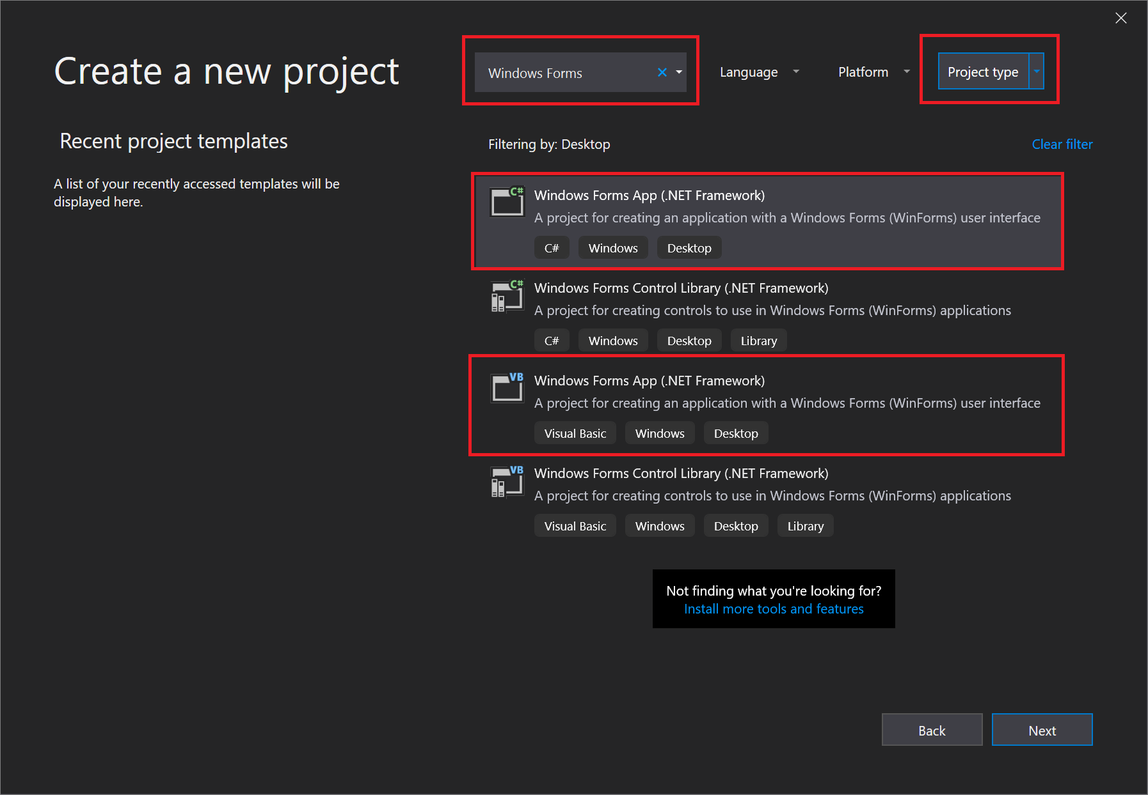
Create a new project

Slide 4
Windows Forms App
When you create a Windows Forms App project, you actually build a program that runs. In this tutorial, your picture viewer app doesn't do much yet—although it will. For now, it displays an empty window that shows Form1 in the title bar.
Here's how to run your app.
Choose one of the following methods:
Choose the F5 key.
On the menu bar, choose Debug > Start Debugging.
On the toolbar, choose the Start Debugging button, which appears as follows:
Start Debugging toolbar button

Slide 5
Windows Forms App
Visual Studio runs your app, and a window called Form1 appears. The following screenshot shows the app you just built. The app is running, and you'll soon add to it.
Windows Forms App, running
Go back to the Visual Studio integrated development environment (IDE), and then look at the new toolbar. Additional buttons appear on the toolbar when you run an application. These buttons let you do things like stop and start your app, and help you track down any errors (bugs) it may have. For this example, we're using it to start and stop the app.
Debugging toolbar
Use one of the following methods to stop your app:
On the toolbar, choose the Stop Debugging button.
On the menu bar, choose Debug > Stop Debugging.
Use your keyboard and press Shift+F5.
Choose the X button in the upper corner of the Form1 window.

Slide 6
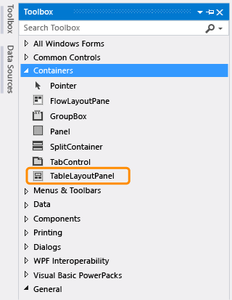
TableLayoutPanel control
On the left side of the Visual Studio IDE, choose the Toolbox tab.
(Alternatively, choose View > Toolbox from the menu bar, or press Ctrl+Alt+X.)
Choose the small triangle symbol next to the Containers group to open it, as shown in the following screenshot.

Slide 7
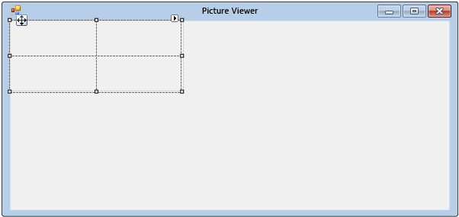
TableLayoutPanel control
You can add controls like buttons, check boxes, and labels to your form. Double-click the TableLayoutPanel control in the Toolbox. (Or, you can drag the control from the toolbox onto the form.) When you do this, the IDE adds a TableLayoutPanel control to your form, as shown in the following screenshot.

Slide 8
TableLayoutPanel control
Be sure the TableLayoutPanel is selected by choosing it. You can verify what control is selected by looking at the drop-down list at the top of the Properties window, as shown in the following screenshot.
Properties window showing TableLayoutPanel control
Choose the Alphabetical button on the toolbar in the Properties window. This sorts the list of properties in the Properties window in alphabetical order, which makes it easier to locate properties in this tutorial.
The control selector is a drop-down list at the top of the Properties window. In this example, it shows that a control called tableLayoutPanel1 is selected. You can select controls either by choosing an area in Windows Forms Designer or by choosing from the control selector.
Now that the TableLayoutPanel is selected, find the Dock property and choose Dock, which should be set to None. Notice that a drop-down arrow appears next to the value. Choose the arrow, and then select the Fill button (the large button in the middle), as shown in the following screenshot.

Slide 9
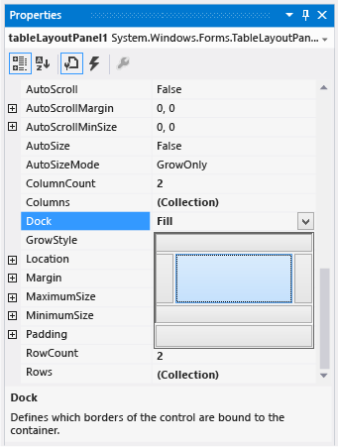
TableLayoutPanel control
Docking in Visual Studio refers to when a window is attached to another window or area in the IDE. For example, the Properties window can be undocked—that is, unattached and free-floating within Visual Studio—or it can be docked against Solution Explorer.

Slide 10
TableLayoutPanel control
After you set the TableLayoutPanel Dock property to Fill, notice that the panel fills the entire form. If you resize the form again, the TableLayoutPanel stays docked, and resizes itself to fit.
Currently, the TableLayoutPanel has two equal-size rows and two equal-size columns. Let's resize them so the top row and right column are both much bigger. In Windows Forms Designer, select the TableLayoutPanel. In the upper-right corner, there is a small black triangle button, which appears as follows.
Triangle button
This button indicates that the control has tasks that help you set its properties automatically

Slide 11
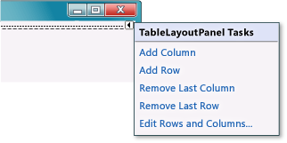
TableLayoutPanel control
Choose the triangle to display the control's task list, as shown in the following screenshot.
TableLayoutPanel tasks
Choose the Edit Rows and Columns task to display the Column and Row Styles window. Choose Column1, and set its size to 15 percent by being sure the Percent button is selected and entering 15 in the Percent box. (That's a NumericUpDown control, which you'll use in a later tutorial.) Choose Column2 and set it to 85 percent. Don't choose the OK button yet, because the window will close. (But if you do, you can reopen it by using the task list.)

Slide 12
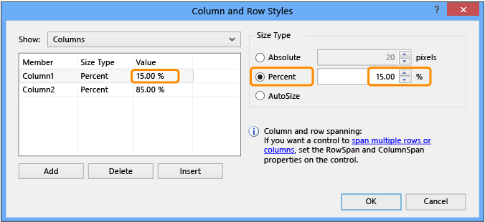
TableLayoutPanel control
Choose the Edit Rows and Columns task to display the Column and Row Styles window. Choose Column1, and set its size to 15 percent by being sure the Percent button is selected and entering 15 in the Percent box. (That's a NumericUpDown control, which you'll use in a later tutorial.) Choose Column2 and set it to 85 percent. Don't choose the OK button yet, because the window will close. (But if you do, you can reopen it by using the task list.)

Slide 13
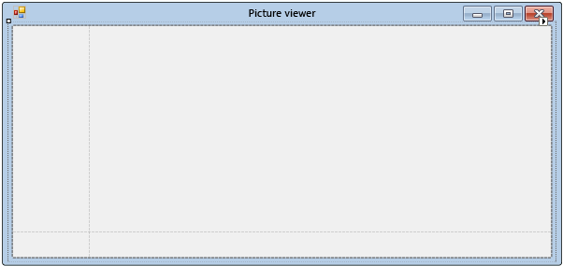
TableLayoutPanel control
From the Show drop-down list at the top of the Column and Row Styles window, choose Rows. Set Row1 to 90 percent and Row2 to 10 percent.
Choose the OK button. Your TableLayoutPanel should now have a large top row, a small bottom row, a small left column, and a large right column. (You can resize the rows and columns in the TableLayoutPanel by choosing tableLayoutPanel1 in the form and then dragging its row and column borders.)

Slide 14
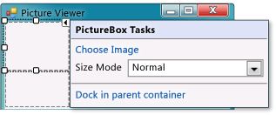
Add controls
Choose the Toolbox tab on the left side of the Visual Studio IDE (or press Ctrl+Alt+X), and then expand the Common Controls group. This shows the most common controls that you see on forms.
Double-click the PictureBox item to add a PictureBox control to your form. Because the TableLayoutPanel is docked to fill your form, the IDE adds the PictureBox control to the first empty cell (the upper left corner).
Choose the new PictureBox control to select it, and then choose the black triangle on the new PictureBox control to display its task list, as shown in the following screenshot.

Slide 15
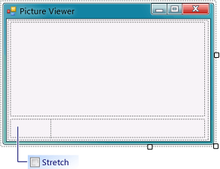
Add controls
In the PictureBox Tasks menu from the PictureBox control, choose the Dock in parent container link. This automatically sets the PictureBox Dock property to Fill. To see this, choose the PictureBox control to select it, go to the Properties window, and be sure that the Dock property is set to Fill.
Make the PictureBox span both columns by changing its ColumnSpan property. In the PictureBox, choose the PictureBox control and set its ColumnSpan property to 2. Also, when the PictureBox is empty, you want to show an empty frame. Set its BorderStyle property to Fixed3D.
Choose the TableLayoutPanel on the form and then add a CheckBox control to the form. Double-click the CheckBox item in the Toolbox to add a new CheckBox control to the next free cell in your table. Because a PictureBox takes up the first two cells in the TableLayoutPanel, the CheckBox control is added to the lower-left cell. Choose the Text property and type in the word Stretch, as shown in the following image.

Slide 16
add buttons
Choose the new FlowLayoutPanel that you added. Go to Common Controls in the Toolbox and double-click the Button item to add a button control called button1 to your FlowLayoutPanel. Repeat to add another button. The IDE determines that there's already a button called button1 and calls the next one button2.
Typically, you add the other buttons by using the Toolbox. This time, choose button2, and then from the menu bar, choose Edit > Copy (or press Ctrl+C). Next, choose Edit > Paste from the menu bar (or press Ctrl+V) to paste a copy of your button. Now paste it again. Notice that the IDE adds button3 and button4 to the FlowLayoutPanel.
Choose the first button and set its Text property to Show a picture. Then set the Text properties of the next three buttons to Clear the picture, Set the background color, and Close.
Let's size the buttons and arrange them so they align to the right side of the panel. Choose the FlowLayoutPanel and look at its FlowDirection property. Change it so it's set to RightToLeft.
The buttons should align themselves to the right side of the cell, and reverse their order so that the Show a picture button is on the right.

Slide 17
add buttons
Choose the Close button to select it. Then, to choose the rest of the buttons at the same time, press and hold the Ctrl key and choose them, too.
After you've selected all the buttons, go to the Properties window and scroll up to the AutoSize property. This property tells the button to automatically resize itself to fit all of its text. Set it to True.
Your buttons should now be sized properly and be in the right order. (As long as all four buttons are selected, you can change all four AutoSize properties at the same time.) The following image shows the four buttons.

Slide 18
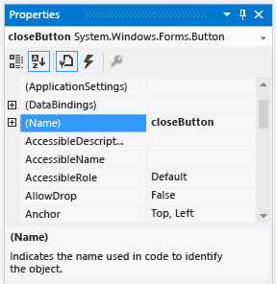
Name your button controls
On the form, choose the Close button. (If you still have all the buttons selected, choose the Esc key to cancel the selection.) Scroll in the Properties window until you see the (Name) property. (The (Name) property is near the top when the properties are alphabetical.) Change the name to closeButton, as shown in the following screenshot.

Slide 19
Name your button controls
Rename the other three buttons to backgroundButton, clearButton, and showButton. You can verify the names by choosing the control selector drop-down list in the Properties window. The new button names appear.
Double-click the Show a picture button on the form. As an alternative, choose the Show a picture button on the form, and then press the Enter key. When you do, the IDE opens an additional tab in the main window named Form1.cs. (If you're using Visual Basic, the tab is named Form1.vb).
This tab displays the code file behind the form, as shown in the following screenshot.

Slide 20
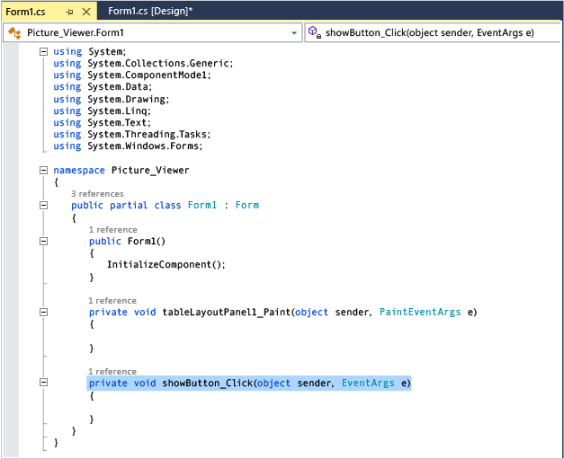
Name your button controls

Slide 21
Button clicks
You're looking at code called showButton_Click() (alternatively, ShowButton_Click()). The IDE added this to the form's code when you opened the code file for the showButton button. At design-time, when you open the code file for a control in a form, code is generated for the control if it doesn't already exist. This code, known as a method, runs when you run your app and choose the control - in this case, the Show a picture button.
Choose the Windows Forms Designer tab again (Form1.cs [Design]), and then open the code file for the Clear the picture button to create a method for it in the form's code. Repeat this for the remaining two buttons. Each time, the IDE adds a new method to the form's code file.
To add one more method, open the code file for the CheckBox control in Windows Forms Designer to make the IDE add a checkBox1_CheckedChanged() method. That method is called whenever the user selects or clears the check box.

Slide 22
Button clicks
private void clearButton_Click(object sender, EventArgs e)
{
}
private void backgroundButton_Click(object sender, EventArgs e)
{
}
private void closeButton_Click(object sender, EventArgs e)
{
}
private void checkBox1_CheckedChanged(object sender, EventArgs e)
{
}

Slide 23
Add dialog components to the form
To add a component called openFileDialog1 to your form, double-click OpenFileDialog. To add a component called colorDialog1 to your form, double-click ColorDialog in the Toolbox. (You use that one in the next tutorial step.) You should see an area at the bottom of Windows Forms Designer (beneath the Picture Viewer form) that has an icon for each of the two dialog components that you added, as shown in the following image.
Dialog components
Choose the openFileDialog1 icon in the area at the bottom of the Windows Forms Designer. Set two properties:
Set the Filter property to the following (you can copy and paste it):
JPEG Files (*.jpg)|*.jpg|PNG Files (*.png)|*.png|BMP Files (*.bmp)|*.bmp|All files (*.*)|*.*
Set the Title property to the following: Select a picture file
The Filter property settings specify the kinds of file types that will display in the Select a picture file dialog box.

Slide 24
Add method
private void showButton_Click(object sender, EventArgs e)
{
if (openFileDialog1.ShowDialog() == DialogResult.OK)
{
pictureBox1.Load(openFileDialog1.FileName);
}
}

Slide 25
Additional buttons
private void clearButton_Click(object sender, EventArgs e)
{
// Clear the picture.
pictureBox1.Image = null;
}
private void backgroundButton_Click(object sender, EventArgs e)
{
// Show the color dialog box. If the user clicks OK, change the
// PictureBox control's background to the color the user chose.
if (colorDialog1.ShowDialog() == DialogResult.OK)
pictureBox1.BackColor = colorDialog1.Color;
}

Slide 26
Additional buttons
private void closeButton_Click(object sender, EventArgs e)
{
// Close the form.
this.Close();
}
private void checkBox1_CheckedChanged(object sender, EventArgs e)
{
// If the user selects the Stretch check box,
// change the PictureBox's
// SizeMode property to "Stretch". If the user clears
// the check box, change it to "Normal".
if (checkBox1.Checked)
pictureBox1.SizeMode = PictureBoxSizeMode.StretchImage;
else
pictureBox1.SizeMode = PictureBoxSizeMode.Normal;
}

